Slide 1
Writing Technical Reports
Yrd. Doç. Dr. YUSUF SEVİM
E-posta: ysevim@ktu.edu.tr

Slide 2
Appendix 1 A checklist for report writing
FORMAT
physical presentation, legibility, layout title page; | stapled or comb-bound; individual plastic sleeves for each page should NOT be used
heading and subheadings | laid out logically and consistently at each level (size and style of headings)
decimal and numbering system | used accurately and consistently; in most cases three levels of heading will suffice

Slide 3
A checklist for report writing
TABLES AND FIGURES
key tables/figures | placed in main body of report: each table and figure must be referred to in the text of report
signifi cant figures | round values to appropriate number of figures; use scaling factors for units and/or scientific notation
captions for tables and figures | concise but self-explanatory; captions for tables placed above the table; captions for figures below the figure
caption information | complements the information stated in the text
data in tables and figures | consistent (cross-checks) with the data in text
symbols, labels and signs | explained clearly
notation/asterisks | explanatory notes provide further information immediately below table/figure
reference citation | if table or figure not your own then cite source

Slide 4
A checklist for report writing
STRUCTURE
names/titles of people etc | spelt correctly and appropriately acknowledged
summary | written to highlight and summarise signifi cant information
table of contents | matches exactly the headings in the report - both label and page number
page numbering | on preliminary pages use Roman numerals; Arabic numerals commence at the introduction; locate at top left hand corner or (less common) bottom centre
definitions of new terms | expressed accurately and clearly
abbreviations and acronyms | written out fully when first used with abbreviations in round brackets
report self-contained | includes all relevant information
appendices | each appendix referred to in main body of report; contains information to support findings; only contains relevant information; do not use to “bulk-up” report

Slide 5
A checklist for report writing
CONTENT
information content | depth and appropriateness; uses sufficient referenced material; author’s opinions/key findings clearly stated; assumptions clearly stated especially if not all information was not known or accessible; information by other authors to support argument is clearly referenced
quality of discussions and conclusions | answers the question/problem/objective posed in the introduction – states how the objective of the study was fulfilled.

Slide 6
A checklist for report writing
REFERENCING
acknowledgement of all sources of information (other than your own) in figure captions, tables and whenever paraphrased or quoted in text | sources of all references citing author and year are placed in main body of report
documented reference list | full bibliographical details provided for all reference sources
elements | all elements of reference provided (author, year, title of publication and publisher) and laid out in preferred style.
punctuation | standardised and consistent – order of elements, punctuation, use of capitals and formatting

Slide 7
A checklist for report writing
TECHNICAL
wordiness | report has been adequately proofread; spelling conforms to Australian standards; redundant or unnecessary words and phrases omitted; uses “Plain English” and avoids “old world words and phrases (eg appertaining to, herewith); avoids colloquialisms
sentences | complete, tight and varied in length; avoids long sentences
passive voice | used appropriately to emphasise the object of action rather than the agent; avoid first person, use third person appropriately.
parallel construction | applied accurately for lists of information
agreement | subjects and verbs are related in number and person, eg she does, they do, it does

Slide 8
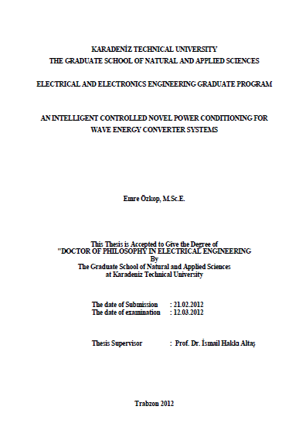
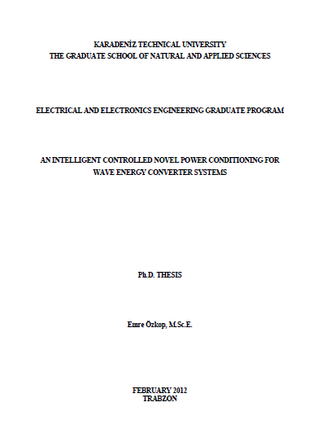
Appendix 2 An Example of a Technical Report
University
Department
Faculty
Title
Dates
Supervisor
Front Cover Page
Cover Page
No page number
No page number

Slide 9
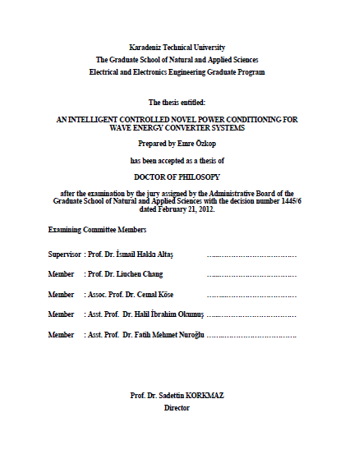
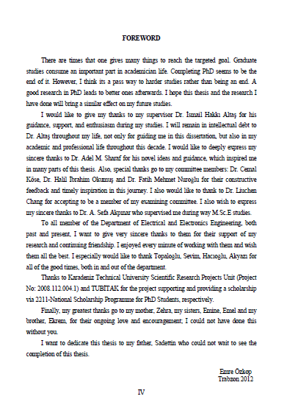
An Example of a Technical Report
Juries
Page numbering in Roman numerals

Slide 10
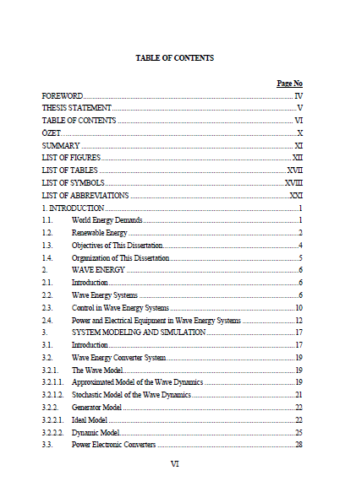
An Example of a Technical Report
A typical layout for a Contents page illustrating the hierarchy used in the report. Note the use of different fonts and indenting to differentiate the report structure hierarchy
Page numbering

Slide 11
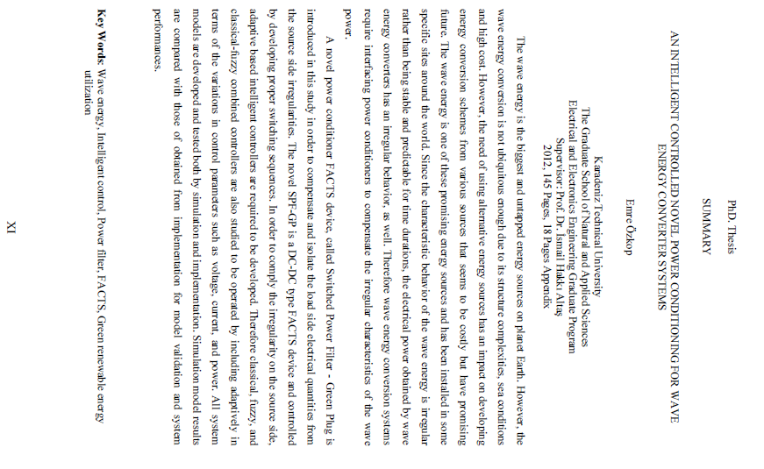
An Example of a Technical Report
The first part of the Abstract introduces the context of the report
Then the aims and scope are presented
And finally, the key results are presented

Slide 12
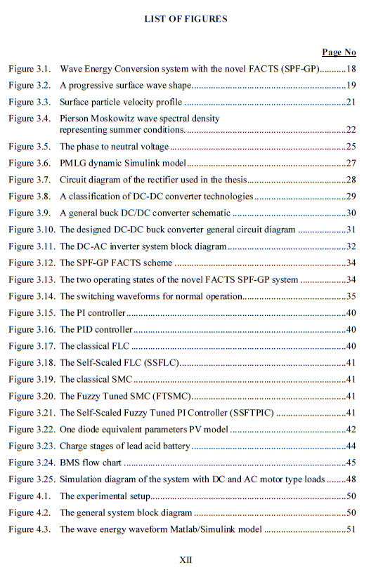
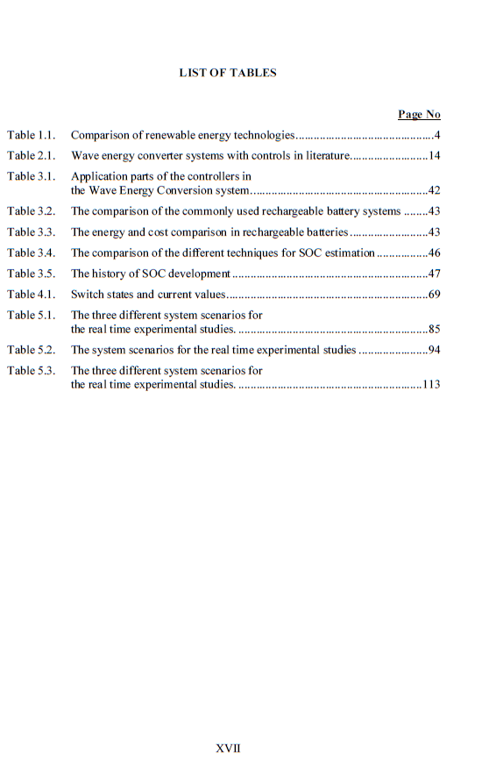
An Example of a Technical Report

Slide 13
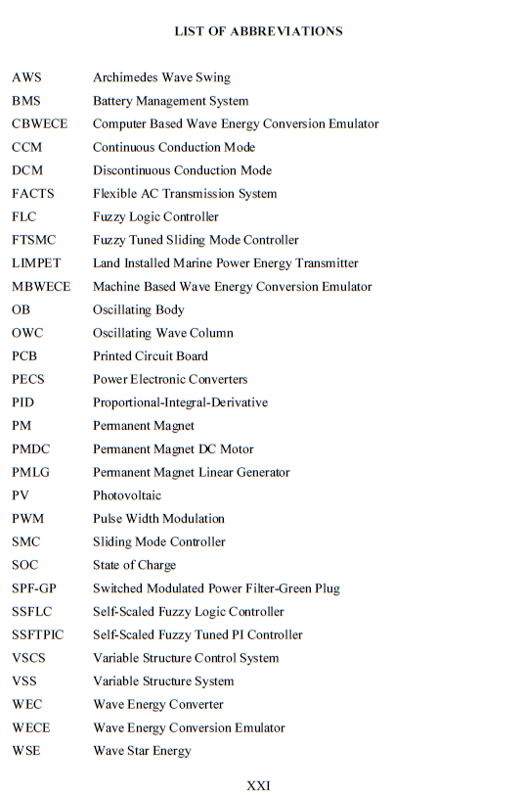
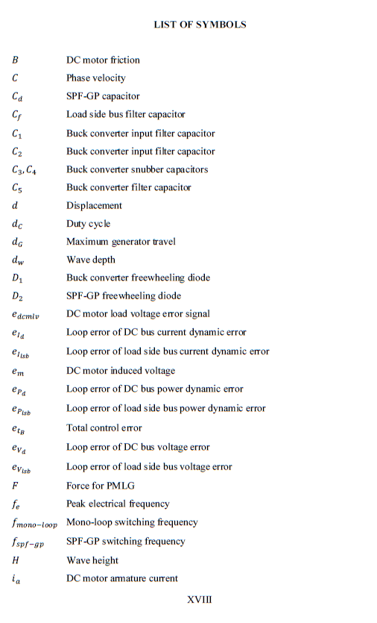
An Example of a Technical Report

Slide 14
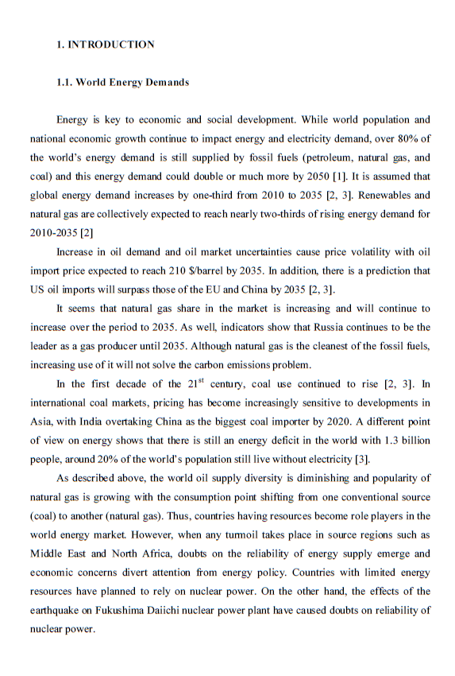
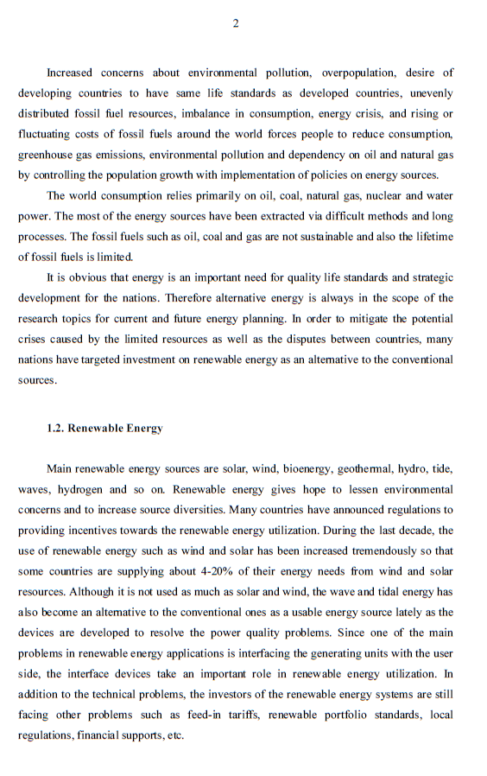
An Example of a Technical Report
No page number
Arabic page numbering
Referencing

Slide 15
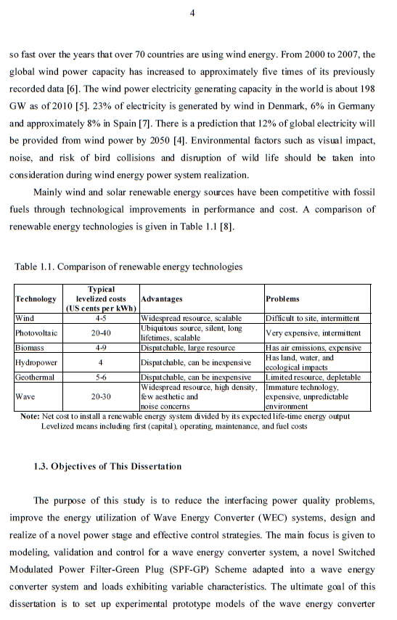
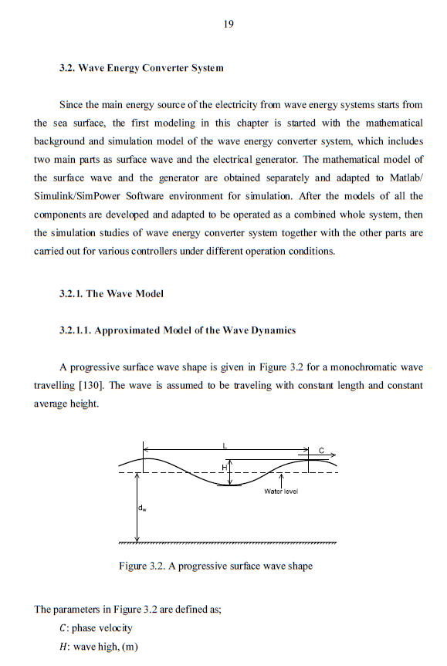
An Example of a Technical Report
Table
Figure

Slide 16
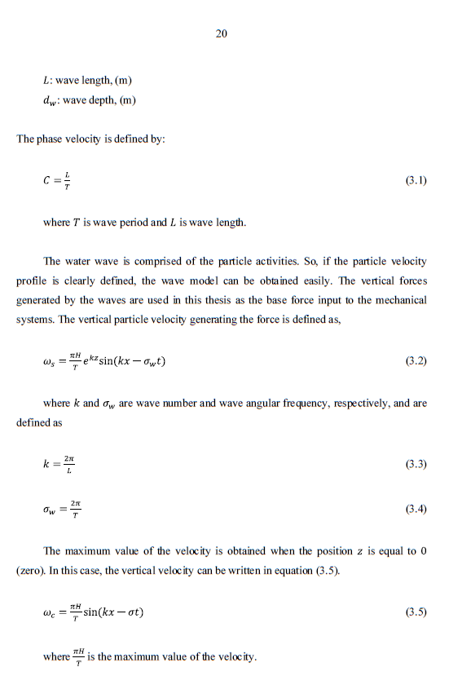
An Example of a Technical Report
Equation
Definition of parameter of equation

Slide 17
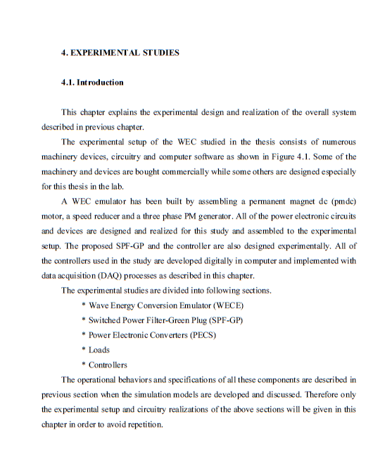
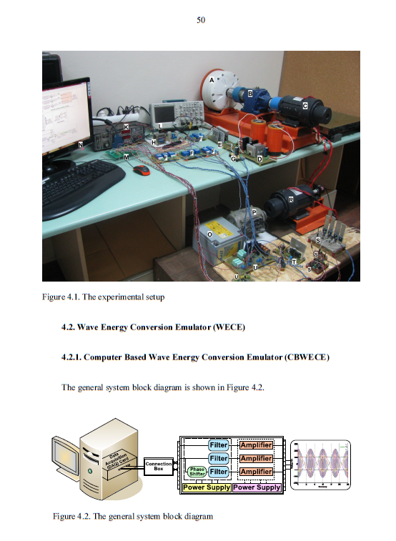
An Example of a Technical Report
No page numbering
New section
Figure caption

Slide 18
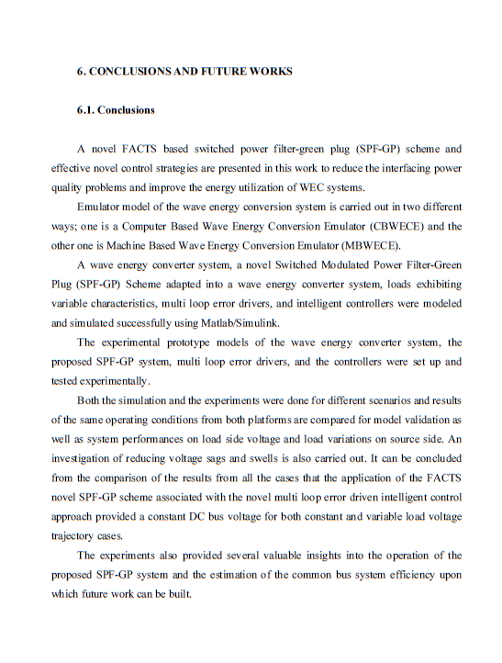
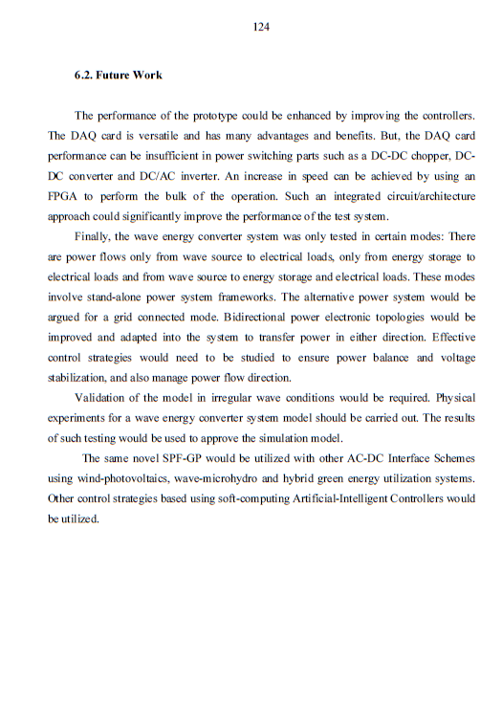
An Example of a Technical Report
No page numbering
Conclusion

Slide 19
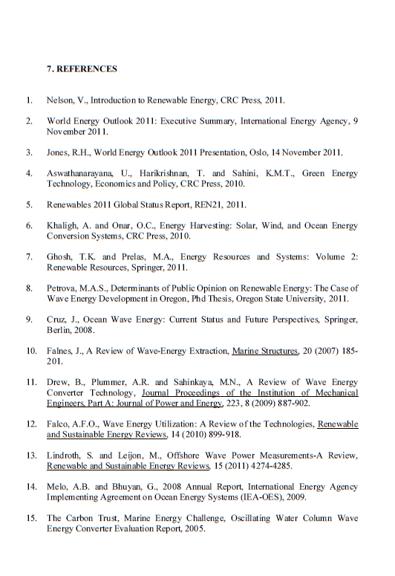
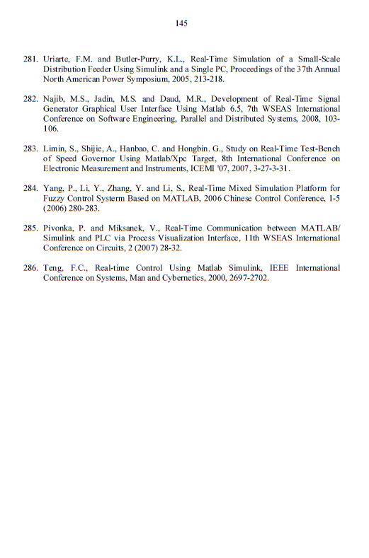
An Example of a Technical Report
No page numbering

Slide 20
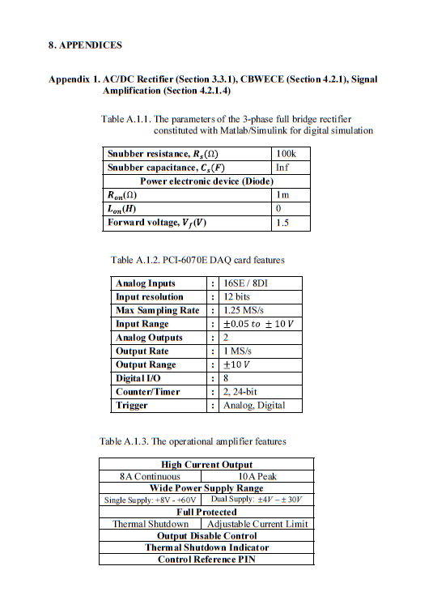
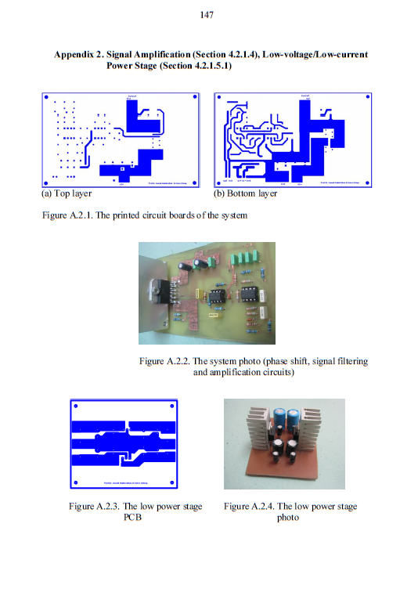
An Example of a Technical Report

Slide 21
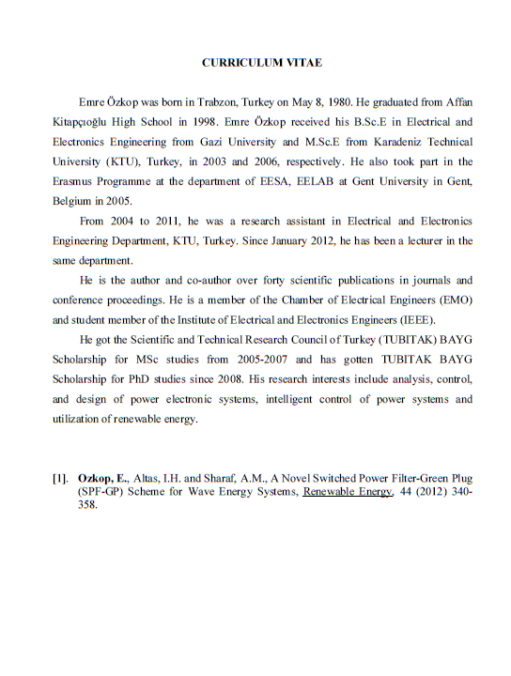
An Example of a Technical Report

